Slide 1
ESOP 101:
Employee Stock Ownership Plans (“ESOPs”)
Presented by
Paige A. Ryan, ESOP Services, Inc.
© ESOP Services Inc. 2014

Slide 2
agenda
Why ESOPs?
What is an ESOP?
ESOP history and facts
ESOP mechanics
Advantages and disadvantages
The process and team
Characteristics of an ESOP candidate

Slide 3

Why ESOPs?
Liquidity in part or whole
  Converting shares into cash at a fair market value, creating liquidity, in part or whole, enabling the business owner(s) to diversify their portfolios
Perpetuation
  Selling shareholders stay involved, if desired
Maximum tax efficiency
  Shareholders, Company, Employees
Broadened ownership
  Employees incentivized to “think like owners”
Strategic planning
  Achieve shareholder and corporate objectives

Slide 4
An ESOP is a transition alternative
Answers the question, “What are my alternatives for business perpetuation and creating liquidity?”
  Sale to third party
  Merger
  Sale to management
  Corporate stock redemption
  Initial public offering
  Gift or other transfer to heirs
  Wind-up business and liquidate
  Leveraged recapitalization
  Sale to Employee Stock Ownership Trust (potentially tax deferred with “tax-free” dollars)

Slide 5
Post sale
Ownership – 100% Transfer
Prior to sale
Company
Company
Shareholder 1
Shareholder 3
Shareholder 2
ESOP
Participant
Participant
Participant
Participant
Employee Stock Ownership Plan
Eligible employees become ESOP participants

Slide 6
Post Transaction Corporate Governance
For a majority ESOP
Nomination
Committee
Nomination Committee Nominates Board of Directors for Trustee to Vote
ESOP
Committee
Board appoints
Board appoints
Audit Committee
Board of Directors
Board appoints/removes Trustee
Trustee(s)
Compensation
Committee
Manages Day to Day Operations of the ESOP
Company
Corporate Governance
Committee
ESOP
Sponsor
* Trustee elects Directors from nominating committee’s slate
6

Slide 7
agenda
Why ESOPs?
What is an ESOP?
ESOP history and facts
ESOP mechanics
Advantages and disadvantages
The process and team
Characteristics of an ESOP candidate

Slide 8
An ESOP is a retirement plan
Qualified, defined contribution, employee benefit plan (ERISA)
    The plan is regulated by the government (IRS and DOL)
Invests primarily in the stock of the sponsoring company
“Qualified” in that sponsoring company, selling shareholders, and employee participants may receive various tax benefits
    The US government has given the company tax breaks for setting up the ESOP

Slide 9
Plan Design
The ESOP Plan
Shareholder Liquidity
Employee Benefits
Cash Flow
Long Term Strategic Plans
Employee Ownership Culture
Valuation
Repurchase Obligation
Capitalization
Seller and Family Wealth
Estate Planning
The ESOP Plan governs
Eligibility
Participation
Vesting
Allocations / Forfeitures
Distribution Policy
Pass-Through Voting
Repurchase Obligation

Slide 10
agenda
Why ESOPs?
What is an ESOP?
ESOP history and facts
ESOP mechanics
Advantages and disadvantages
The process and team
Characteristics of an ESOP candidate

Slide 11
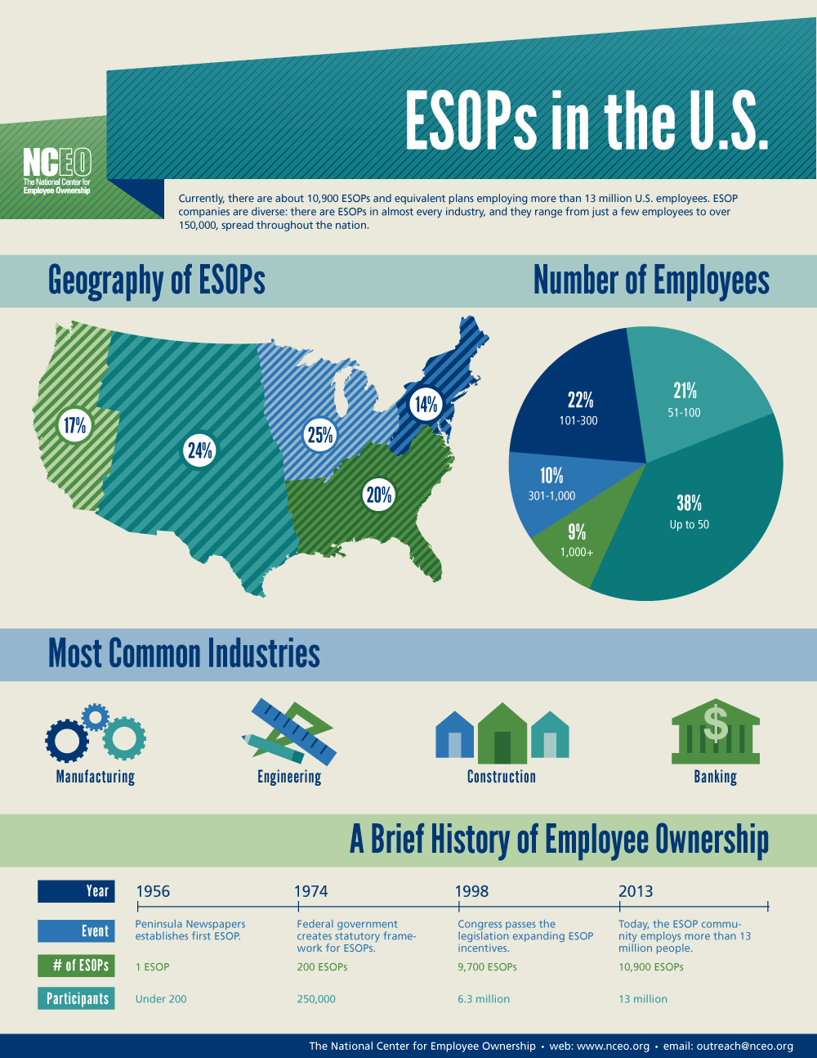
History of ESOPs
www.esopinfo.org

Slide 12
www.esopinfo.org

Slide 13

ESOP Statistics
10,000 ESOPs in U.S., covering 10.3 million employees (10% of the private sector workforce)
~5,000 majority owned by the ESOP
~4,000 are 100% owned by the ESOP
Found in all industries
72% of The ESOP Association’s members are companies with fewer than 250 employees
At least 70% of ESOP’s are or were leveraged, i.e. they used borrowed funds to acquire stock bought by the ESOP
As small as a few dozen employees and as large as 84,000
(Source: The ESOP Association 08/2013)

Slide 14

ESOP Companies
More productive
More profitable
Higher survival rates
esopassociation.org
nceo.org
esopinfo.org

Slide 15
agenda
Why ESOPs?
What is an ESOP?
ESOP history and facts
ESOP mechanics
Advantages and disadvantages
The process and team
Characteristics of an ESOP candidate

Slide 16
TRANSACTION DESIGN ALTERNATIVES
Non-leveraged
Progressive
Redemption and sale
Leveraged
Combination

Slide 17






Non – Leveraged
Company
Company sets up an ESOP Trust
Company makes annual tax deductible contributions in cash or stock to the ESOP trust
Cash is used to buy stock from current shareholders
Shares are allocated to the accounts of eligible employees within the ESOP, typically based on salary
ESOP holds stock for participants and annually notifies them of how much stock is in their account and the value of the stock in their account
Employees collect stock or cash, according to a vesting schedule, when they retire or otherwise leave the company
Stock
Shareholder(s)
ESOP Accounts
Allocated Shares
Allocated Shares
Allocated Shares
Former Participants

Slide 18
Leveraged ESOPs
Financing Alternatives
The ESOP receives a loan to purchase stock from current shareholders
  These stock is held in trust and released into employee accounts at a rate corresponding to debt amortization
ESOPs typically acquire a block of stock with leverage (“debt”) funded by one or a combination of:
  Bank(s)
  Excess company cash
  Private equity group (PEG)
  Selling shareholder(s)
  Management investment (rare)
  Broad-based employee investment (rare)
  Combination (typical)

Slide 19




Company
100% Leveraged ESOP with seller debt
(1) ESOP buys stock from existing shareholders with a note
(2) Shares are held in Suspense Account
(3) Company makes annual tax-deductible contributions to ESOP to repay seller and bank debt
(4) Shares are released from suspense account and allocated each year as ESOP repays sellers with contributions
(5) Employees receive stock or cash when they retire or leave (vesting applies)
(3) Contribution
(1) ESOP buys Stock with Note
Suspense Account
ESOP Accounts
(2) Shares to Suspense
(4) Allocated Shares
Stock
(4) Allocated Shares
Loan Payments
(4) Allocated Shares
Shareholder(s)
(5) Stock or Cash

Slide 20





100% Leveraged ESOP (bank and seller debt)
$10M Value
$5M Bank debt
$5M Seller Notes
(1) Bank lends $5M to company
(2) Company lends $5M to ESOP
(3) ESOP buys stock from existing shareholders
(4) Shares are held in suspense account
(5) Company makes annual tax-deductible contributions to ESOP to repay seller and bank debt
(6) Shares are released from suspense account and allocated each year as ESOP repays company loan
(7) The ESOP then repays company, who then repays the bank and sellers
(8) Employees receive stock or cash when they retire or leave (vesting applies)
Company
(1) $5M Bank Loan to Company
(7) Periodic Payment ($500k)
(2)
$5M Co.
Loan to ESOP
(7) $500K Payment
(5)
$1M Contribution
(7) $1M
Payment
(4) Shares
to Suspense
Suspense Account
ESOP Accounts
(3) ESOP buys stock with
$5M cash from bank and
$5M note (which is modified
with company post closing)
Allocated Shares
Allocated Shares
Allocated Shares
Shareholders
(8) Stock or Cash

Slide 21
How is stock price determined?
By law the ESOP may not pay more than fair market value as determined by an independent valuation firm and trustee
Company’s stock price will be determined annually by the ESOP Trustee based on an independent valuation firm’s determination of fair market value
ESOP Trustee
  Expertise in ESOP trustee services
  Appointed to act on behalf of ESOP participants
Independent Valuation Firm
  Independent and experienced in valuation
  Utilize expertise, experience, industry standards, and guidelines provided by IRS

Slide 22
agenda
Why ESOPs?
What is an ESOP?
ESOP history and facts
ESOP mechanics
Advantages and disadvantages
The process and team
Characteristics of an ESOP candidate

Slide 23
Tax advantages
Tax-deductible principal repayment [IRC 404(a)(9)]
Tax-free S corporation income [IRC 409(p) and 512(a)]
Tax-deferred sale - C corporation stock [IRC 1042]
Tax-deductible dividends “C” corporation [IRC § 404(k)]
Contributions may be reimbursable under federal government cost-plus contracts
ESOPs are frequently in addition to a 401(k) plan

Slide 24

Advantages
Company
Substantial tax savings
Increased cash flow
Pre-tax dollars repay debt
Tax-free income, S Corp ESOP stockholder not subject to federal and most states mirror
Stockholders
Liquidity in part or whole
IRC 1042 “tax-free” rollover
Selling shareholders can remain involved (if desired)
Employees
Share in equity growth
Research shows ESOP companies more likely to have other retirement-oriented benefit plans
Proven motivator
Retains key employees

Slide 25
Disadvantages
Requires debt to purchase larger blocks of stock
  Seller can finance
  Bank and bonding approval must be considered
Repurchase obligation
  Planning for funding options important
The tax favors and employee benefits can be spectacular
  Compliance with regulations: IRS, DOL, ERISA
Complexity
  Experienced advisors essential

Slide 26
Perpetuation planning C corporation
IRC 1042 “Tax-Free” rollover
Seller must have owned stock for at least three years prior to sale:
  Seller cannot have acquired the stock in a compensatory stock option plan or any other section 83 transaction, nor from a qualified retirement plan
  Seller, certain related individuals, and greater-than-25% owners generally cannot participate in ESOP allocations
10% excise tax applies if ESOP disposes of stock within three years, except for normal benefit distribution
Above rules do not apply if seller does not elect the “tax-free” rollover

Slide 27
Perpetuation planning C corporation
IRC 1042 “Tax-Free” rollover
Seller must have owned stock for at least three years prior to sale:
  Seller cannot have acquired the stock in a compensatory stock option plan or any other section 83 transaction, nor from a qualified retirement plan
  Seller, certain related individuals, and greater-than-25% owners generally cannot participate in ESOP allocations
10% excise tax applies if ESOP disposes of stock within three years, except for normal benefit distribution
Above rules do not apply if seller does not elect the “tax-free” rollover

Slide 28
Tax Status Conversion
C to S or S to C
IRC 1042 “tax-free” rollover as C Corporation transaction, then convert to S Corporation
S Corporation convert to C for “tax-free” Rollover – five-year wait to convert to S
100% shareholder approval for S Corporation election

Slide 29
agenda
Why ESOPs?
What is an ESOP?
ESOP history and facts
ESOP mechanics
Advantages and disadvantages
The process and team
Characteristics of an ESOP candidate

Slide 30
The process
Preliminary Analysis
Employee communications
Phase I
Decision Package
Valuation estimate
Feasibility study, creating a “decision package”
Phase II Implementation
Plan and trust, and transaction documents
Financing
Repurchase obligation planning/funding
Independent transaction valuation
Phase III
Ongoing
Repurchase obligation
Annual administration and valuation
No cost
Confidential
30,000 foot view
Notes:
Paige
30

Slide 31
Trusted advisors
ESOP consultant
  Prepares feasibility study, the decision package, to ascertain viability and “quarterbacks” implementation
Corporate counsel and CPA, other advisor(s)
  Supporting and advising as needed
Third party plan administrator
  Handles annual record keeping and compliance testing
Independent appraiser
  Determines fair-market value
Trustee(s)
  Acts on behalf of the ESOP and purchases stock
ESOP counsel
  Drafts plan, trust and transaction documents
  Advises trustee(s) and other fiduciaries
ESOP team
Notes:
You will need an experienced advisory team.

Slide 32
agenda
Why ESOPs?
What is an ESOP?
ESOP history and facts
ESOP mechanics
Advantages and disadvantages
The process and team
Characteristics of an ESOP candidate

Slide 33

“Ideal” Candidate
“C” or “S”- corporation, LLC’s can convert
History of good cash flows
Stock is privately held
Shareholder interest in liquidity/diversification
Sufficient payroll
Debt capacity
Shareholder interest in maintaining legacy of business and employee continuity
Solid successor management team with interest in stock
Notes:
Paige

Slide 34
Is an ESOP right for you, and your company?
Notes:
Paige

Slide 35
The answer: it depends…
On shareholder goals and objectives
  Estate planning, personal financial needs, time table, control
Business’s Strategic Plan
  Projected growth, successor management, cash flow, employee benefits levels, ownership culture
Current economic considerations
  Valuation, transaction financing, tax implications, current legislative environment
Notes:
Paige

Slide 36
Next Steps
Learn more
  www.esopservices.com
  References
    Selected upon request
    Partial list at
    www.esopservices.com/reference.html
Preliminary Analysis
Call or email with questions!

Slide 37
ESOP Services, Inc.
www.esopservices.com
Founded in 1984, ESOP Services, Inc. responds to the needs of business owners to understand and analyze the ESOP’s impact on the company, shareholders, and employees, focusing on the financial aspects of cash flow, tax savings, shareholder liquidity, and employee benefits.
We specialize in all aspects of Employee Stock Ownership Plans for both private and public companies throughout the United States and internationally. Our unique approach emphasizes the financial aspects of ESOPs, while coordinating the many diverse elements necessary to successfully establish an ESOP.
Paige Ryan Ron Gilbert
San Diego, CA 92142 Scottsville, VA 24590
Phone: 858.292.4819 Phone: 434.286.3130
paige@esopservices.com esop@esopservices.com

